Slide 1
Applications of the Integral Session 15 - 16
Course : MATH 6031 – Calculus
Year : 2021

Slide 2
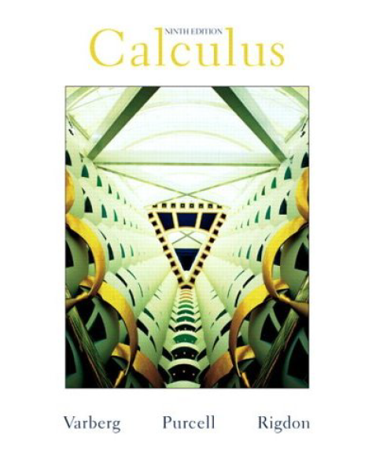
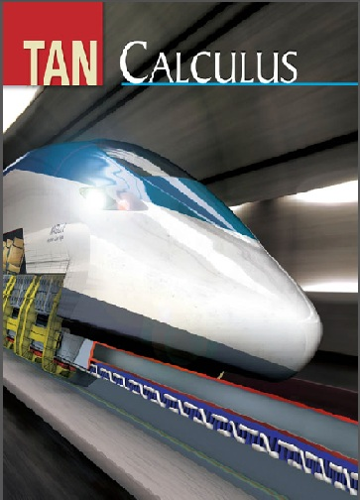
These slides have been adapted from: Dale Varberg, Edwin Purcell, Steve Rigdon. 2007. Calculus. Prentice Hall. ISBN: 978-0132306331. Soo.T.Tan. Calculus. 2010. Brooks/Cole. ISBN-13: 978-0-534-46579-7
Acknowledgement

Slide 3

Learning Objectives
LO 3:
Explain the properties of integral to describe geometric and physical problems, and
other applications.

Slide 4
Content
1
Area
2
Volume

Slide 5
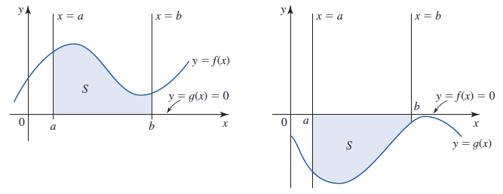
Area
If the region S is just the region under the graph of f on [a,b], then the area is
$$\int_{a}^{b}{f\left(x\right)dx}$$
If the region S is just the region under the graph of f on [a,b], then the area is
∫_𝑎^𝑏▒𝑓(𝑥)𝑑𝑥
If the region S is just the region upper the graph of g on [a,b], then the area is
$$\int_{a}^{b}{g\left(x\right)dx}$$
If the region S is just the region upper the graph of g on [a,b], then the area is
∫_𝑎^𝑏▒𝑔(𝑥)𝑑𝑥

Slide 6
A Helpful Way of Thinking
Sketch the region
Slice it into thin pieces (strips); label a typical piece
Approximate the area of this typical piece as if it were a rectangle
Add up the approximations to the areas of the pieces
Take the limit as the width of the pieces approaches zero, thus getting a definite integral.

Slide 7
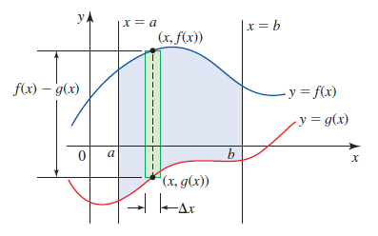
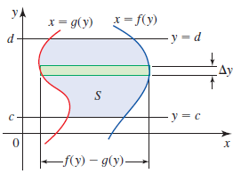


A Region Between Two Curves
Vertical Slicing
Horizontal Slicing
Area = $\int_{a}^{b}{\left(f\left(x\right)−g(x)\right)dx}$
Area = $\int_{c}^{d}{\left(f\left(y\right)−g(y)\right)dy}$
1
2

Slide 8
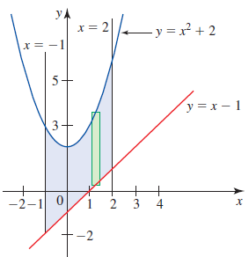
Example 1
Find the area of the region between the graphs of y = x² +2 and y = x -1 and the vertical lines x = -1 and x = 2.
Solution
Observe that the graph of
y = x² +2 lies above that of
y = x -1.
Therefore, if we let f(x) = x² +2
and g(x) = x -1, then
f(x) ≥ g(x) on [-1,2]

Slide 9
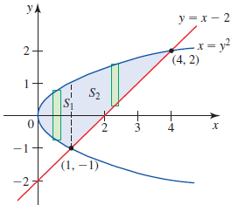
Example 2 (1/2)
Find the area of the region bounded by the graphs of x = y² and y = x -2.
Solution
The region S is shown in Figure.
The points of intersection of the two
curves are found by solving the
equations x = y² and y = x -2
simultaneously. The point are (1,1)
and (4,2).
This observation suggests that we consider the area of to be the sum of the areas of S₁ and S₂.

Slide 10
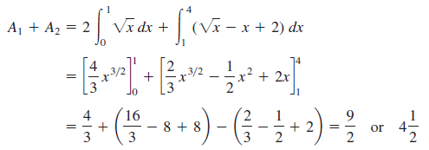
Example 2 (2/2)
If the area S₁ is A₁ and the area of S₂ is A₂, then the region S is

Slide 11
What is Volume?
In each case, the solid is generated by moving a plane region (the base) through a distance h in a direction perpendicular to that region.
And in each case, the volume of the solid is defined to be the area A of the base times the height h; that is,
V = A h

Slide 12

Volume: Riemann Sum
Riemann Sum
The “volume” V of the solid should be given by the Riemann sum
Integral
Let the norm of the partition approach zero, we obtain a definite integral that defined to be the volume of the solid.
$$V=\int_{a}^{b}{A\left(x\right)dx}$$
Let the norm of the partition approach zero, we obtain a definite integral that defined to be the volume of the solid.
𝑉=∫24_𝑎^𝑏▒𝐴(𝑥)𝑑𝑥
$$V≈\sum_{i=1}^{n}{A\left(\overline{x_{i}}\right)Δx_{i}}$$
𝑉≈∑_(𝑖=1)^𝑛▒〖𝐴((𝑥_𝑖 ) ̅ )Δ𝑥_𝑖 〗

Slide 13
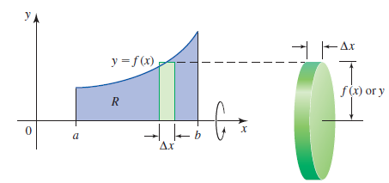
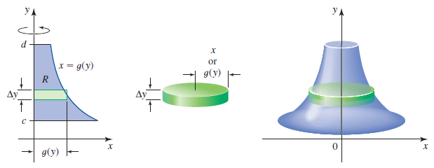
Solids of Revolution:
Method of Disks
X - Axis
Y - Axis
$$v=π\int_{a}^{b}{{\left[f\left(x\right)\right]}^{2}dx}$$
𝑣=𝜋∫24_𝑎^𝑏▒〖[𝑓(𝑥)]^2 𝑑𝑥〗
$$v=π\int_{c}^{d}{{\left[g\left(y\right)\right]}^{2}dy}$$
𝑣=𝜋∫_𝑐^𝑑▒〖[𝑔(𝑦)]^2 𝑑𝑦〗

Slide 14
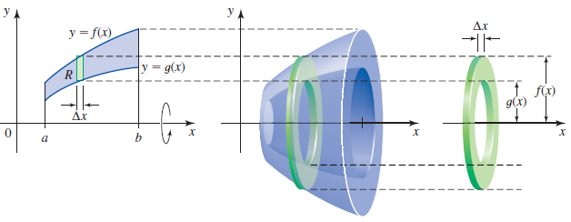
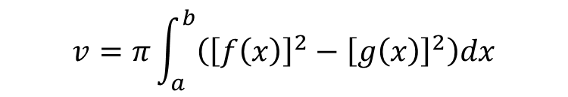
Method of Washers
$$v=π\int_{a}^{b}{\left({\left[f\left(x\right)\right]}^{2}−{\left[g\left(x\right)\right]}^{2}\right)dx}$$

Slide 15
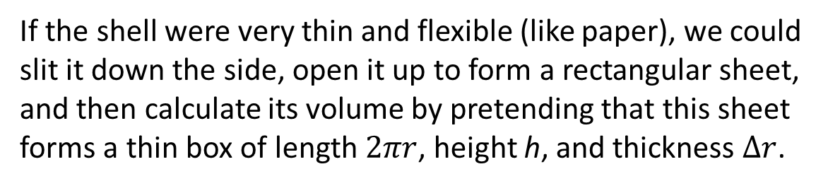
A Cylindrical Shell
If the shell were very thin and flexible (like paper), we could slit it down the side, open it up to form a rectangular sheet, and then calculate its volume by pretending that this sheet forms a thin box of length $2πr$, height h, and thickness $Δr$.

Slide 16
The Method of Shells
$$ΔV≈2πxf\left(x\right)Δx$$
$$V=2π\int_{a}^{b}{xf\left(x\right)dx}$$
Δ𝑉≈2𝜋𝑥𝑓(𝑥)Δx
𝑉=2𝜋∫24_𝑎^𝑏▒𝑥𝑓(𝑥)𝑑𝑥

Slide 17
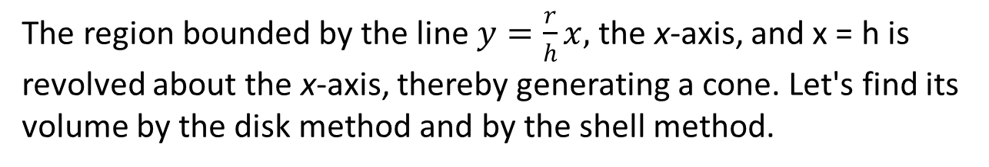
Example
The region bounded by the line $y=\frac{r}{h}x,$ the x-axis, and x = h is revolved about the x-axis, thereby generating a cone. Let's find its volume by the disk method and by the shell method.

Slide 18
Plane Curve
How long is the spiral curve shown in Figure? If it were a piece of string, most of us would stretch it taut and measure it with a ruler. But if it is the graph of an equation, this is a little hard to do.
A little reflection suggests a prior question. What is a plane curve? We have used the term curve informally until now, often in reference to the graph of a function.

Slide 19
Arc Length
y = f(x)
x = g(y)
If the curve is given by
$$y=f\left(x\right), a≤x≤b$$
we treat x as the parameter and arc length L becomes
$$L=\int_{a}^{b}{\sqrt{1+{\left(\frac{dy}{dx}\right)}^{2}}}$$
If the curve is given by
$$x=g\left(y\right), c≤x≤d$$
we treat x as the parameter and arc length L becomes
$$L=\int_{c}^{d}{\sqrt{1+{\left(\frac{dx}{dy}\right)}^{2}}}$$
1
2

Slide 20
Example
Let's find the length of the arc of the curve
$y=x^{\frac{3}{2}}$ from the point (1, 1) to the point (4, 8).
Note that $\frac{dy}{dx}=\frac{3}{2}x^{\frac{1}{2}}$
Let's find the length of the arc of the curve
𝑦=𝑥^(3/2) from the point (1, 1) to the point (4, 8).
Note that 𝑑𝑦/𝑑𝑥=3/2 𝑥^(1/2)
$$L=\int_{1}^{4}{\sqrt{1+{\left(\frac{3}{2}x^{\frac{1}{2}}\right)}^{2}}dx}=\int_{1}^{4}{\sqrt{1+\frac{9}{4}x}dx}={\left[\frac{8}{27}{\left(1+\frac{9}{4}x\right)}^{\frac{3}{2}}\right]}_{1}^{4}$$
$$≈7.63$$
𝐿=∫24_1^4▒〖√(1+(3/2 𝑥^(1/2) )^2 ) 𝑑𝑥〗=∫_1^4▒〖√(1+9/4 𝑥) 𝑑𝑥〗=[8/27 (1+9/4 𝑥)^(3/2) ]_1^4
≈7.63

Slide 21
Work Done
Work = W = Force . Distance = F.D
$$W=\lim_{Δx→0}{\sum_{i=1}^{n}{F\left(x_{i}\right)Δx}}$$
𝑊=lim_(Δ𝑥→0)⁡∑24_(𝑖=1)^𝑛▒𝐹(𝑥_𝑖 )𝛥𝑥
$$W=\int_{a}^{b}{F\left(x\right)dx}$$
𝑊=∫24_𝑎^𝑏▒𝐹(𝑥)𝑑𝑥

Slide 22
Continuous Mass Distribution along a Line
Density
Supposing that
Mass and Moment
The total mass
Center of Mass
$$\overline{x}=\frac{M}{m}$$
𝑥 ̅=𝑀/𝑚
$$\overline{x}=\frac{\int_{a}^{b}{xδ\left(x\right)dx}}{\int_{a}^{b}{δ\left(x\right)dx}}$$
𝑥 ̅=(∫_𝑎^𝑏▒𝑥𝛿(𝑥)𝑑𝑥)/(∫_𝑎^𝑏▒𝛿(𝑥)𝑑𝑥)
the density at x
is $δ(x)$
is 𝛿(𝑥)
the total moment
$$m=\int_{a}^{b}{δ\left(x\right)dx}$$
𝑚=∫24_𝑎^𝑏▒𝛿(𝑥)𝑑𝑥
$$M=\int_{a}^{b}{xδ\left(x\right)dx}$$
𝑀=∫_𝑎^𝑏▒𝑥𝛿(𝑥)𝑑𝑥

Slide 23
Example
The density $δ\left(x\right)$of a wire at the point x centimeters from one end is given by $δ\left(x\right)=3x^{2}$ grams per centimeter.
The center of mass of the piece between x = 0 and x = 10 is
$$\overline{x}=\frac{\int_{0}^{10}{x.3x^{2}}dx}{\int_{0}^{10}{3x^{2}}dx}=\frac{{\left[\frac{3x^{4}}{4}\right]}_{0}^{10}}{{\left[x^{3}\right]}_{0}^{10}}=7.5 cm$$

Slide 24
Mass Distributions in the Plane
Mass
Mass
Moment
$$M_{y}=δ\int_{a}^{b}{x\left[f\left(x\right)−g(x)\right]dx}$$
𝑀_𝑦=𝛿∫_𝑎^𝑏▒𝑥[𝑓(𝑥)−𝑔(𝑥)]𝑑𝑥
Center of Mass
$$\overline{x}=\frac{M_{y}}{m} \overline{y}=\frac{M_{x}}{m}$$
𝑥 ̅=𝑀_𝑦/𝑚 𝑦 ̅=𝑀_𝑥/𝑚
$$M_{x}=\frac{δ}{2}\int_{a}^{b}{\left[f^{2}\left(x\right)−g^{2}(x)\right]dx}$$
𝑀_𝑥=𝛿/2 ∫_𝑎^𝑏▒[𝑓^2 (𝑥)−𝑔^2 (𝑥)]𝑑𝑥
where $δ$ is density
where 𝛿 is density
$$m=δ\int_{a}^{b}{\left[f\left(x\right)−g(x)\right]dx}$$
𝑚=𝛿∫24_𝑎^𝑏▒[𝑓(𝑥)−𝑔(𝑥)]𝑑𝑥

Slide 25
Example
Find the centroid of the region bounded by the curves $y=x^{3}$ and $y=\sqrt{x}$
$$\overline{x}=\frac{\int_{0}^{1}{x\left(\sqrt{x}−x^{3}\right)dx}}{\int_{0}^{1}{\left(\sqrt{x}−x^{3}\right)dx}}=\frac{12}{25}$$
1
X - Axis
2
$$\overline{y}=\frac{\int_{0}^{1}{\frac{1}{2}\left(\sqrt{x}+x^{3}\right)\left(\sqrt{x}−x^{3}\right)dx}}{\int_{0}^{1}{\left(\sqrt{x}−x^{3}\right)dx}}=\frac{3}{7}$$
Centroid
4
Y - Axis
3

Slide 26
Dale Varberg, Edwin Purcell, Steve Rigdon. 2007. Calculus. Prentice Hall. ISBN: 978-0132306331.
Dale Varberg, Edwin Purcell, Steve Rigdon. 2014. Calculus Early Transcendentals. Pearson New International Edition. ISBN: 978-1-292-04268-8
Soo.T.Tan. 2010. Calculus. Brooks/Cole. ISBN-13: 978-0-534-46579-7

